Slide 1
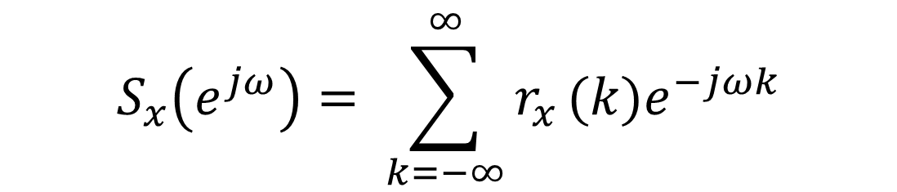
Análisis del espectro de potencia basado en Fourier
$$S_{x}\left(e^{jω}\right)= \sum_{k=−∞}^{∞}{r_{x }(k)e^{−jωk}}$$

Slide 2
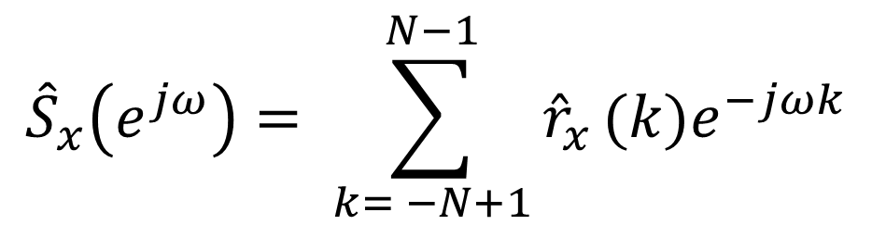
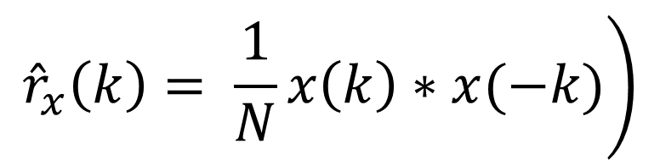
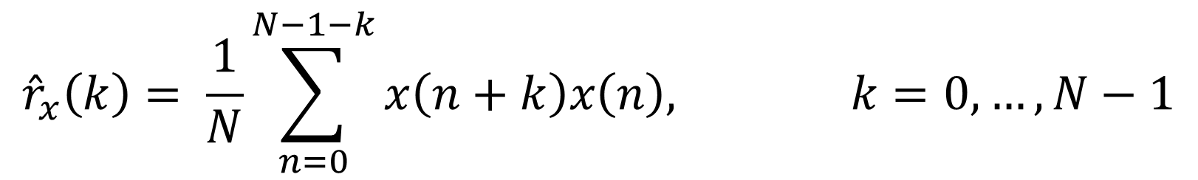
$${\hat{r}}_{x}\left(k\right)= \frac{1}{N}\sum_{n=0}^{N−1−k}{x\left(n+k\right)x\left(n\right), k=0, …, N−1}$$
$${\hat{S}}_{x}\left(e^{jω}\right)= \sum_{k= −N+1}^{N−1}{{\hat{r}}_{x }(k)e^{−jωk}}$$
Por ser la correlación
simétrica
Periodograma
$$\left.{\hat{r}}_{x}\left(k\right)= \frac{1}{N}x\left(k\right)∗x(−k)\right)$$

Slide 3
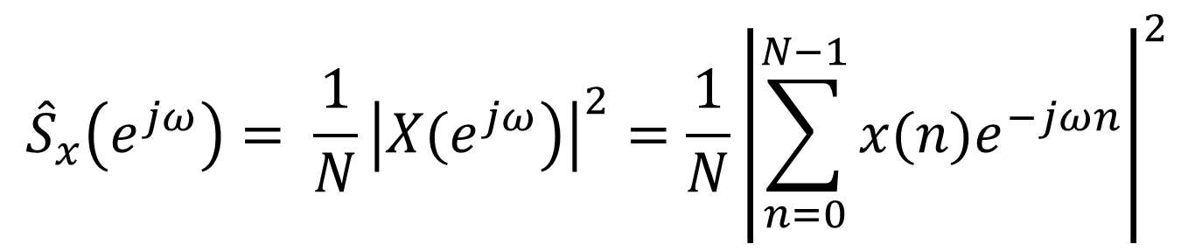
Espectro de potencia
$${\hat{S}}_{x}\left(e^{jω}\right)= \frac{1}{N}{\left|\left.X(e^{jω}\right)\right|}^{2}=\frac{1}{N}{\left|\sum_{n=0}^{N−1}{x(n)e^{−jωn}}\right|}^{2}$$

Slide 4
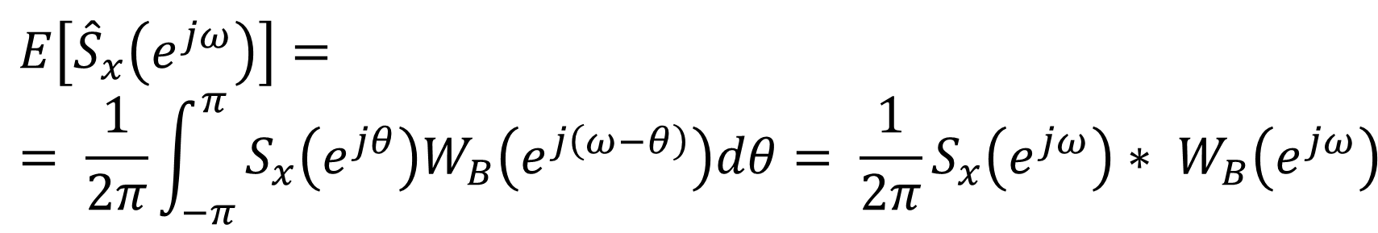
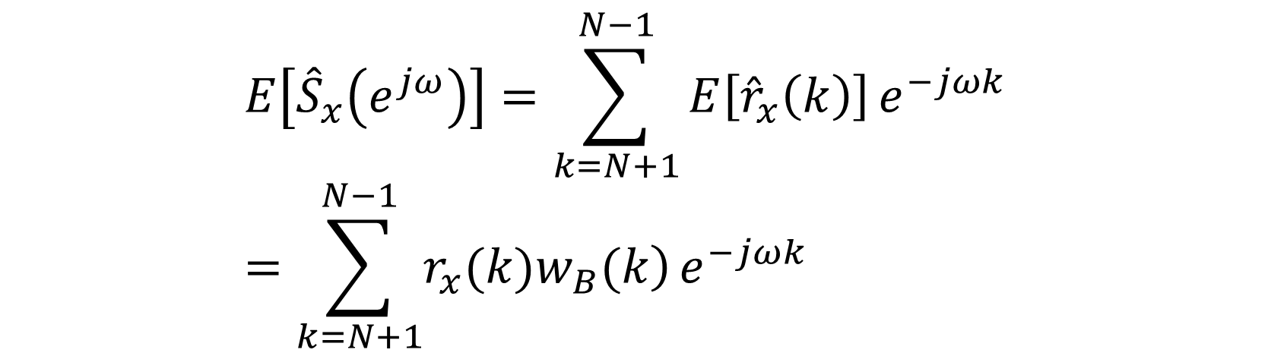
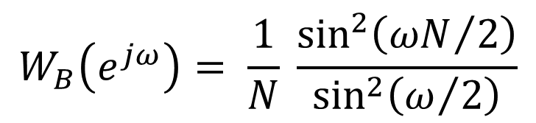
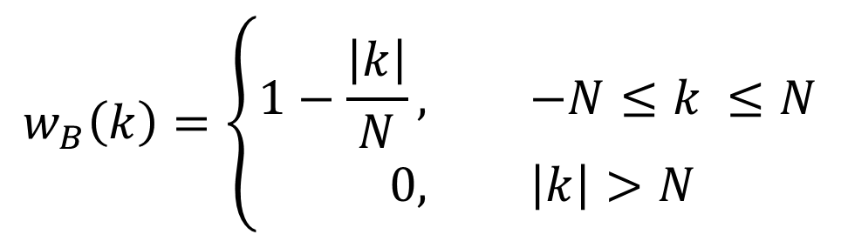
Propiedades del periodograma
$$E\left[{\hat{S}}_{x}\left(e^{jω}\right)\right]=\sum_{k=N+1}^{N−1}{E\left[{\hat{r}}_{x}\left(k\right)\right]}e^{−jωk} =\sum_{k=N+1}^{N−1}{\left.r_{x}(k)w_{B}(k\right)}e^{−jωk}$$
$$w_{B}\left(k\right)=\left\{\begin{aligned}1−\frac{\left|k\right|}{N}, &−N≤k ≤N \\ 0, &\left|k\right|>N\end{aligned}\right.$$
$$W_{B}\left(e^{jω}\right)= \frac{1}{N} \frac{\sin^{2}\left({ωN}/2\right)}{\sin^{2}\left(ω/2\right)}$$
$$E\left[{\hat{S}}_{x}\left(e^{jω}\right)\right]== \frac{1}{2π}\int_{−π}^{π}{S_{x}\left(e^{jθ}\right)W_{B}\left(e^{j\left(ω−θ\right)}\right)dθ= \frac{1}{2π}S_{x}\left(e^{jω}\right)∗ W_{B}\left(e^{jω}\right)}$$

Slide 5
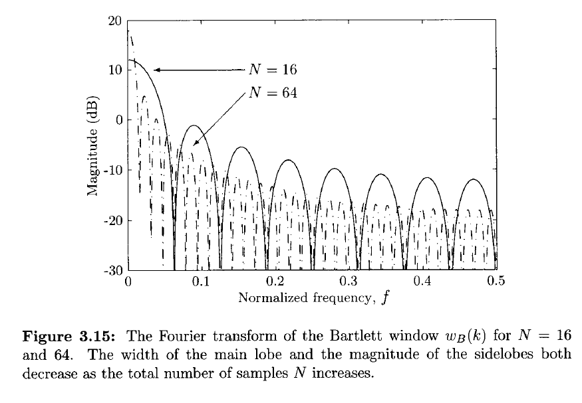

Slide 6
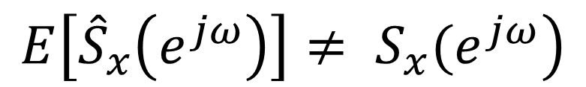
El periodograma es un estimador sesgado de la media
$$\left.E\left[{\hat{S}}_{x}\left(e^{jω}\right)\right]≠ S_{x}(e^{jω}\right)$$

Slide 7
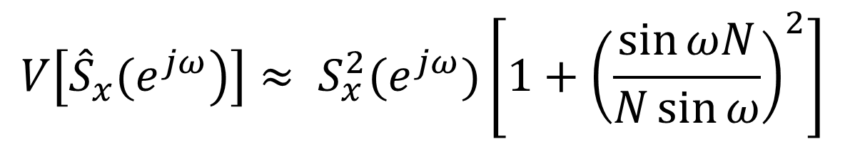

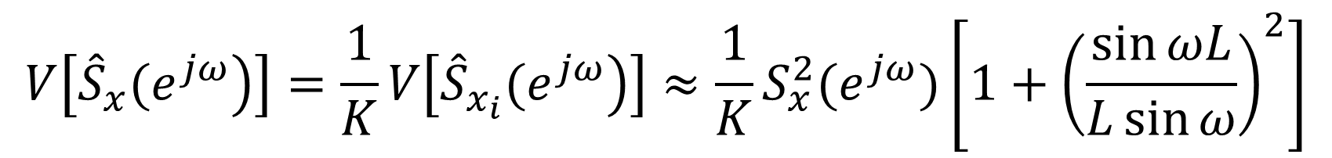
$$V\left[\left.{\hat{S}}_{x}(e^{jω}\right)\right]≈ S_{x}^{2}(e^{jω})\left[1+{\left(\frac{\sin{ωN}}{N\sin{ω}}\right)}^{2}\right]$$
$$x_{i}\left(n\right)=x\left(n+iL\right), n=0, …, L−1; i=0, …, K−1$$
$$N=KL$$
$$V\left[\left.{\hat{S}}_{x}(e^{jω}\right)\right]=\frac{1}{K}V\left[\left.{\hat{S}}_{x_{i}}(e^{jω}\right)\right]≈\frac{1}{K}S_{x}^{2}(e^{jω})\left[1+{\left(\frac{\sin{ωL}}{L\sin{ω}}\right)}^{2}\right]$$

Slide 8
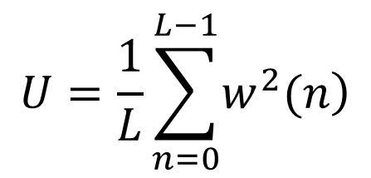
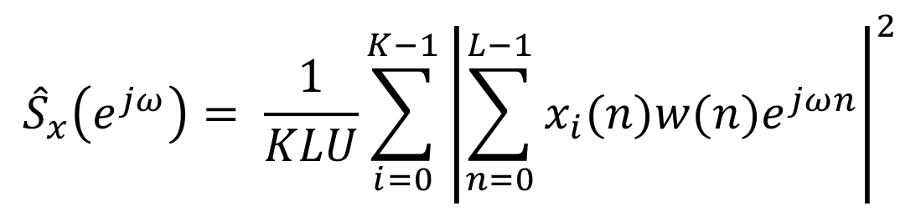
$${\hat{S}}_{x}\left(e^{jω}\right)= \frac{1}{KLU}\sum_{i=0}^{K−1}{{\left|\sum_{n=0}^{L−1}{x_{i}(n)w(n)e^{jωn}}\right|}^{2}}$$
$$U=\frac{1}{L}\sum_{n=0}^{L−1}{\left.w^{2}(n\right)}$$

